Slide 1
hdufhdaukj
OPEN
By: Jadi Miller, Devin Wyatt, Joanna Hernandez
Jayla Dickerson and Chris Meadows

Slide 2
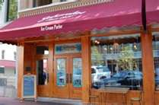
Zaharakos Where and When
Zaharakos is a family restaurant. It opened in 1900, it’s 111 years old. It’s located on 329 on Washington st. Columbus, Indiana. It’s open Monday thru Friday 8am to 8pm and also on Saturday to Sunday 8am to 9pm. Did you know that in 2008 it took two years to restore it from the flood. Their phone number is 812-378-1900.
This is the front view of the Zaharakos restaurant. I

Slide 3
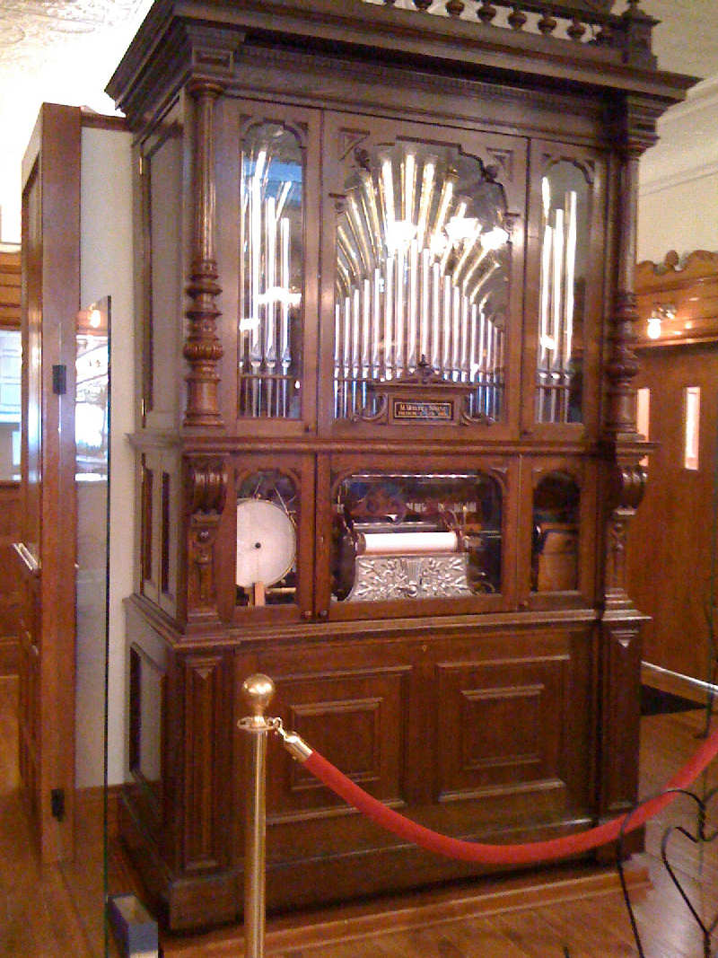
The Organ
Inside the restaurant you will find a large, old aged organ. The organ in Zaharakos plays by itself, in 1908 the Zaharako family added musical delight to the menu with the Welt Orchestrion. The real name of the organ is the Welte Orchestrion Restored, in 2006 the Welte Orchestrion was sold, but in 2007 it was bought back by owner, Anthony Morvec.
This is what the organ looks like inside of Zaharakos

Slide 4
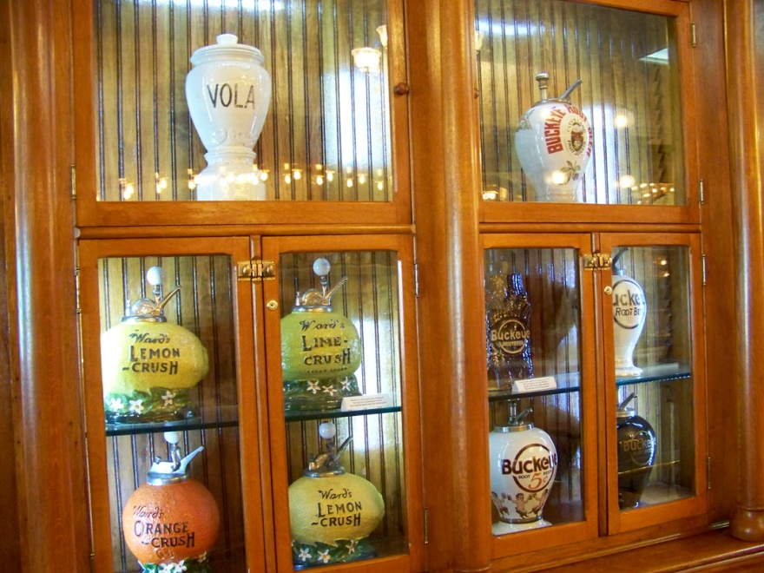
Zaharako’s Who and What goes on
The Zaharakos museum is the oldest part of the whole restaurant, when you visit the Zaharakos museum you will learn about soda fountains and mechanical music. Not only does Zaharakos have a museum it also has a country store! Also, Zaharakos was the first place in Columbus, Indiana to have a soda fountain. Zaharakos has a lot of thing to do, and it’s very unique.
This is part of the Zaharako’s museum

